Slide 1


River Sunny Bank
Database Administration Capstone Project Fall 2023 – Group 3
Faculty: Dr. Theo Owusu
Presented By: Wahiba Pereira | Wenxin Liang | Samy Baker | Mason Young

Slide 2
Overview
Summary & Overview
Design requirements
Data Structure
ERD Diagram
Platform Selection
Overview
Database Creation
Website Application
Database Schema
SQL Statements
Walkthrough
Data Population
Triggers
Stored Procedures
Roles & Permissions
Visualization & Analytics
Overview
Documentation
Recommendation for Implementation
Questions and Comments
Insights

Slide 3
Summary & Overview
Content
River Sunny Bank leverages its database system for streamlined management of customer information and financial transactions, ensuring secure and efficient banking services.
Objective
Optimize banking operations by focusing on efficient checking and savings transactions, ensuring seamless account management, robust transaction tracking, and fortified data security for an enhanced customer experience.
System Components
Simplify transactions, streamline deposits, facilitate easy loan applications, and enhance website navigation for a seamless and user-friendly banking experience.
Features
Quick Data Upload
Real-Time Updates
Customizable Interface
Notes:
Wahiba

Slide 4
Design Requirements
1. Customer Management
﻿﻿Store and manage customer information including names, addresses, and contact details.
Provide functionalities for searching and retrieving customer details.
2. Account Handling
Maintain records of different types of accounts (savings, checking, loans, credit cards, etc.).
﻿﻿Support account creation, closure, and updating account information.
3. Transaction Processing
Record and manage various transactions such as account number, transaction type, amount, date. Ensure data security for all transaction related information.
Notes:
Cindy

Slide 5
Design Requirements
4. Employee and Branch Management:
Maintain employee records including personal details, positions, department, pay, pay type and branch.
Improve branch management by storing branch details.
Enable employee and branch association for managing operations efficiently.
5. Loan and Credit Card:
﻿﻿Manage loan applications, approvals, and disbursements.
Track loan details including loan types, amounts, interest rates, terms, and statuses.
6. Security and Access Control:
﻿﻿Maintain audit trails and logs for monitoring system activities and user actions.
Notes:
Cindy

Slide 6
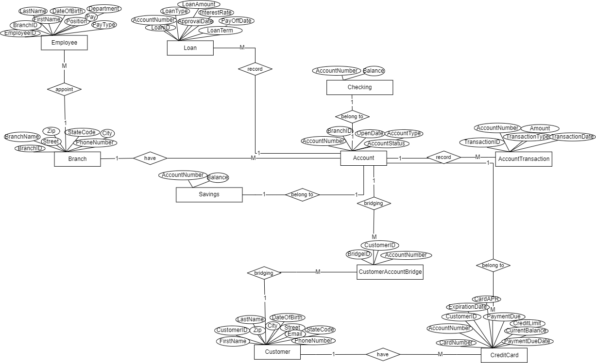
Overview of Data Structure
ERD Diagram
Notes:
Cindy

Slide 7
Overview of Data Structure
ERD Diagram
Notes:
Cindy

Slide 8
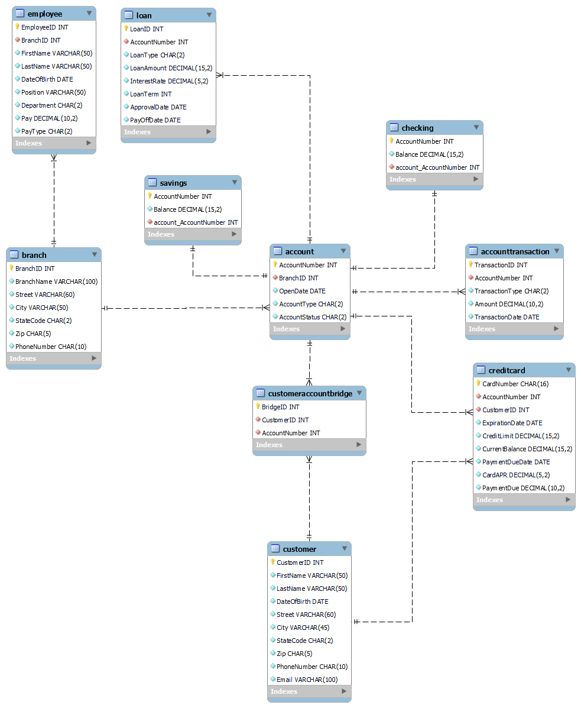
Overview of Data Structure
Database Schema
Notes:
Cindy

Slide 9
Overview of Data Structure
Database Schema
Notes:
Cindy

Slide 10
Overview of Data Structure
Database Schema
Notes:
Cindy

Slide 11
Database Creation
Platform Selection
Technologies Used:
Developed with ASP.NET on Visual Studio for robust and scalable solutions.
SQL Server employed for efficient data storage, ensuring performance.
Database Management:
Opted for SQL Server to guarantee robust data storage and seamless management.
Web Development:
Utilized ASP.NET in Visual Studio for web development, ensuring a responsive and user-friendly interface.
Notes:
Wahiba

Slide 12
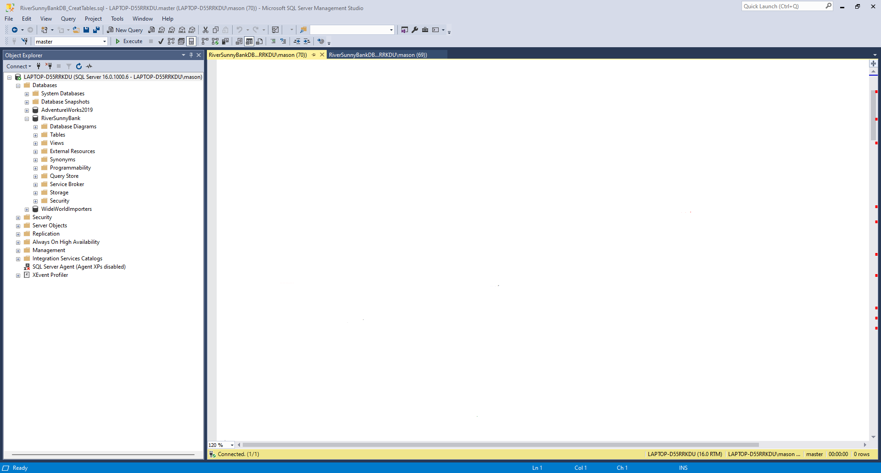
Database Creation
SQL Statements | Data Population | Stored Procedures
Notes:
Mason

Slide 13

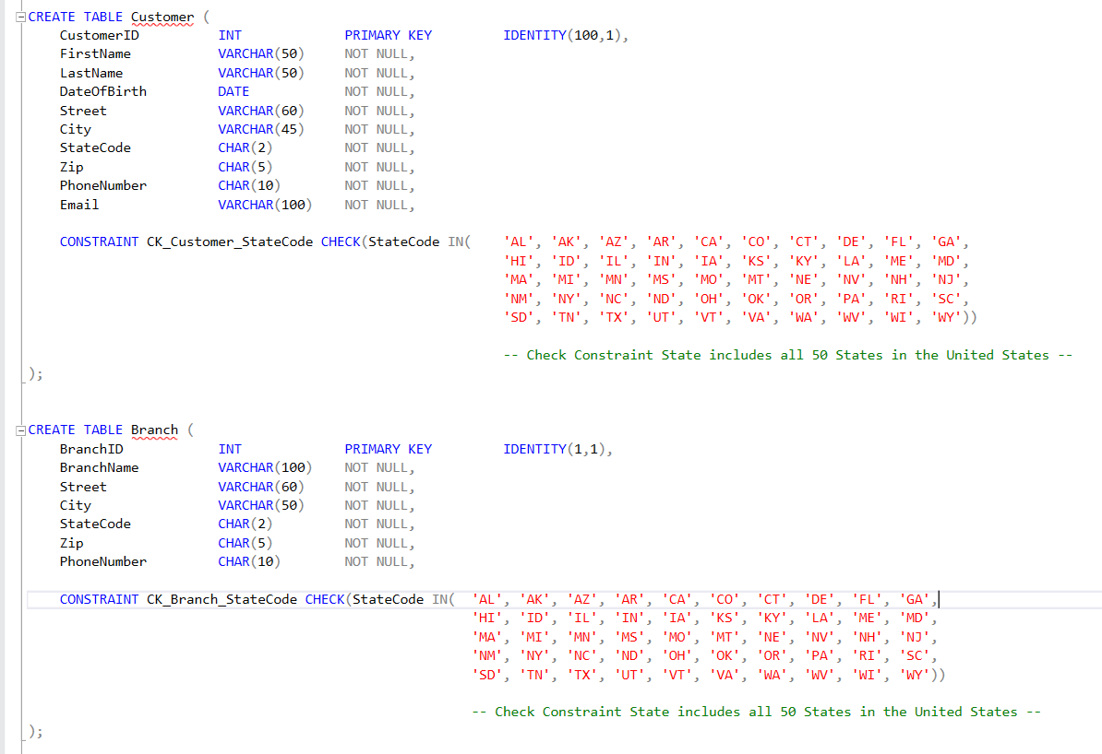
Database Creation
Example SQL Statements: CREATE TABLE
SQL Statements
Notes:
10 Total CREATE TABLE statements
Here, we see both tables for Customer and Branch entities
We had quite a few check constraints to ensure that the data remains accurate:
State Abbreviations
Account Types
Account Status Codes
Transaction Type Codes
Loan Type Codes

Slide 14
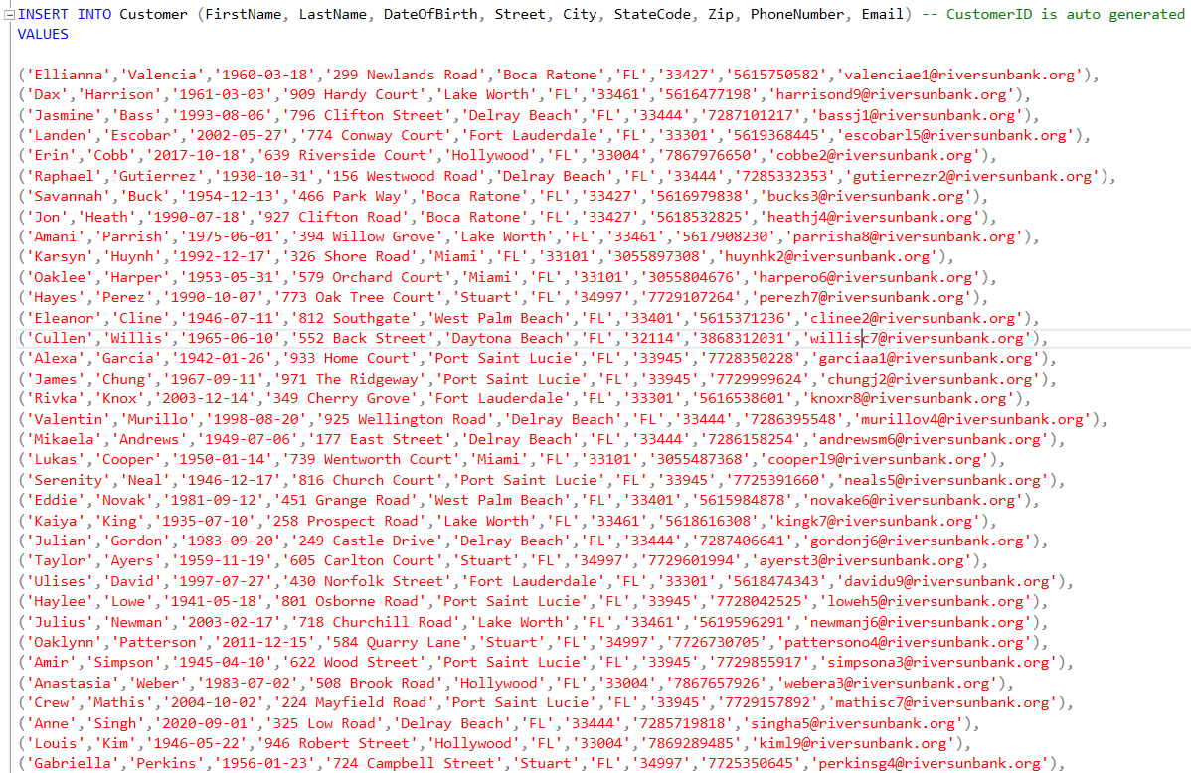
Database Creation
Example SQL Statements: Data Population
SQL Statements
Notes:
For our data, we employed the help of Excel using formulas along with a few random name generators to generate a larger data set. This was chosen for the purpose of providing an additional feature: a dashboard with Power BI.
We created 1000 unique customers that altogether have opened over 500 accounts total with almost 200 million dollars held in accounts.

Slide 15
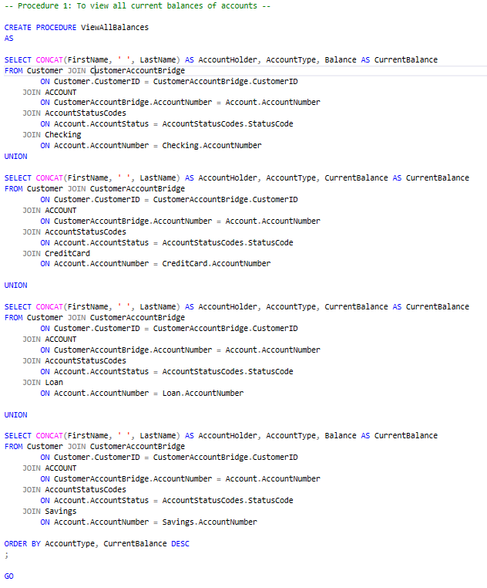
Database Creation
Stored Procedures
SQL Statements
Page 1
Notes:
For our first stored procedure, we are able to run and see a list of all accounts that shows who owns the account, what type of account, and the balance of the account. We are able to see a collective list that shows all types of accounts by using union statements and switching out the table for each account type in the last join statement.

Slide 16
Database Creation
Stored Procedures
SQL Statements
Page 2

Slide 17
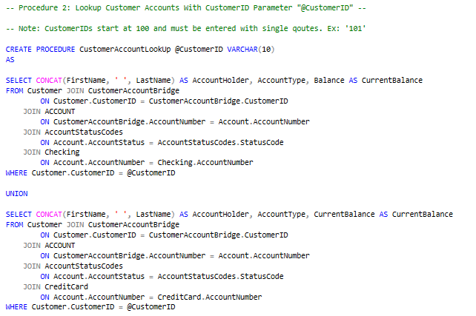
Database Creation
Stored Procedures
SQL Statements
Page 1
Notes:
In the second stored procedure, it is similar to the first stored procedure but instead filters the list of all accounts by a parameter for the customer ID. This allows a user to pull a result set for all accounts given that they know the customerID.

Slide 18
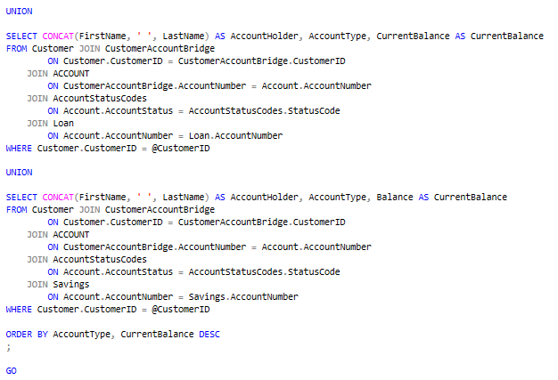
Database Creation
Stored Procedures
SQL Statements
Page 2

Slide 19
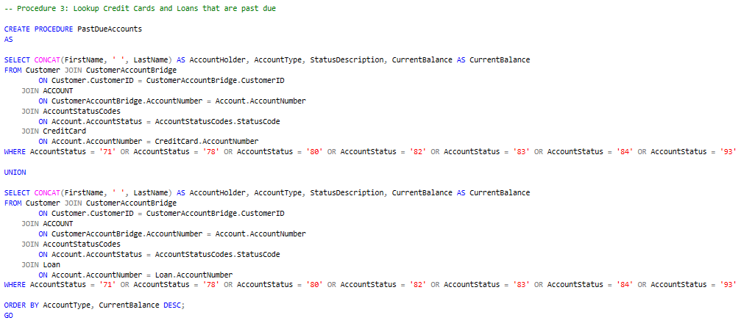
Database Creation
Stored Procedures
SQL Statements
Notes:
In the third stored procedure, a user is able to quickly look up all Credit and Loan accounts that are in default status. This is achieved by filtering the result set using the account status codes in the WHERE clause

Slide 20
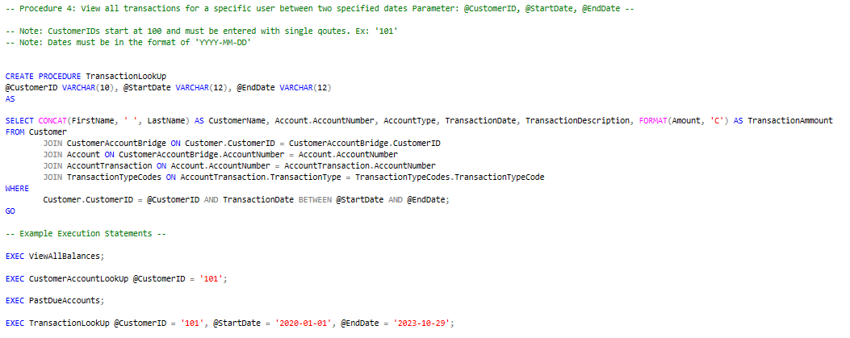
Database Creation
Stored Procedures
SQL Statements
Notes:
For a final stored procedure, we give the ability to look up specific transactions given three parameters: CustomerID, a start date and an end date. This allows users to find specific transactions that may need to be investigated.

Slide 21
Database Creation
Triggers
UpdateAccountStatus Trigger:
Objective: Automate Account Status Updates
Logic:. Updates Account table for real-time consistency.
LogBranchPhoneNumberChange Trigger:
Objective: Capture and Log Branch Phone Number Changes
Logic: Triggers on Branches after UPDATE. Captures changes, logs details for auditing.
LogCustomerEmailChange Trigger:
Objective: Track Modifications to Customer Email Addresses
Logic: Triggers on Customers after UPDATE. Captures changes, maintains historical record.
Benefits:
Efficiency, Automates updates, reduces manual efforts.
Notes:
Wahiba

Slide 22
Database Creation
Roles & Permissions
Bank Admin:
Full control over the entire database.
Authority to modify, delete, or update any records.
Configuration and management of user roles and permissions.
Access to sensitive financial data for auditing and reporting.
Teller:
Access to customer account information for transactions.
Authority to process deposits, withdrawals, and fund transfers.
Limited access to sensitive customer data for transactional purposes.
View-only access to certain administrative reports.
Customer Service:
Access to customer information for account inquiries and support.
Ability to update customer contact details and personal information.
Limited access to transaction history for customer assistance.
View-only access to specific reports for customer service purposes.
Auditor:
Read-only access for auditing purposes.
Authority to run and review audit reports.
Access to transaction logs and system activity.
Limited access to specific financial reports for auditing purposes.
Notes:
Sam

Slide 23
Database Creation
Roles & Permissions
Managerial Roles:
Access to managerial reports and analytics.
Authority to oversee and manage employee roles and permissions.
View-only access to sensitive financial reports.
Limited access to modify specific configurations for operational efficiency.
IT Administrator:
Full control over database infrastructure.
Authority to implement and manage security protocols.
Configuration and maintenance of database backups.
Access to error logs and troubleshooting tools.
Customer:
Access to personal account information.
Ability to view transaction history.
Limited access to perform account-related actions (e.g., change password).
No access to sensitive administrative or financial reports.
Compliance Officer:
Access to regulatory compliance reports.
Authority to ensure database adherence to legal standards.
Limited access to sensitive customer data for compliance auditing.
View-only access to specific financial and regulatory reports.
Notes:
Sam

Slide 24
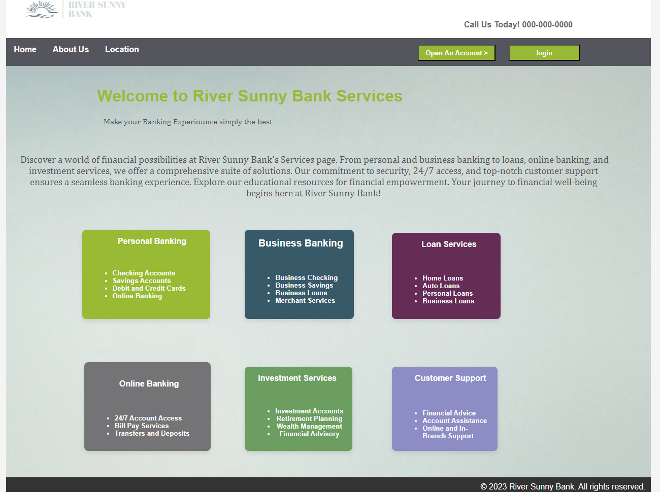
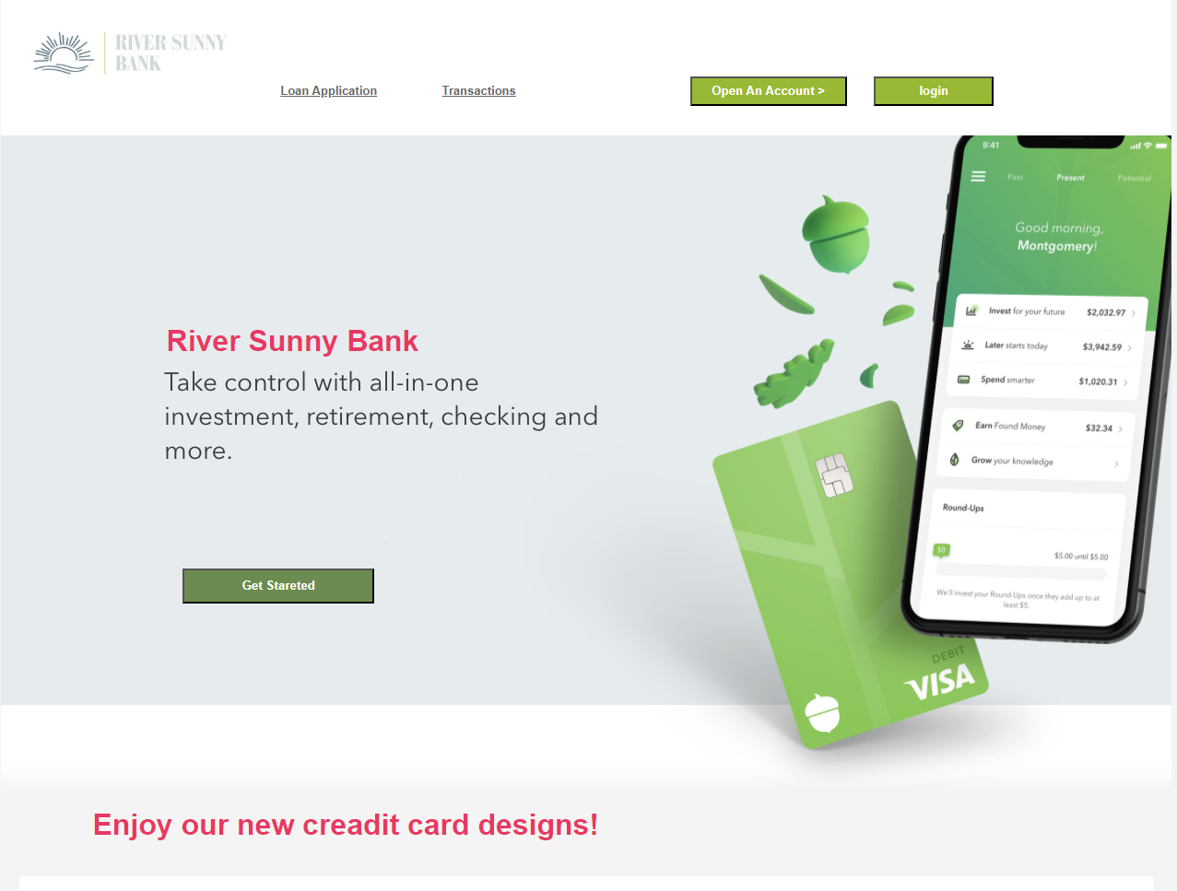
Website Application
Live walkthrough and Demo – Wahiba
Notes:
Wahiba

Slide 25
Notes:
Live Demo waiting screen for Wahiba. Change screen share to Wahiba. When done, switch screen share back to Mason.

Slide 26
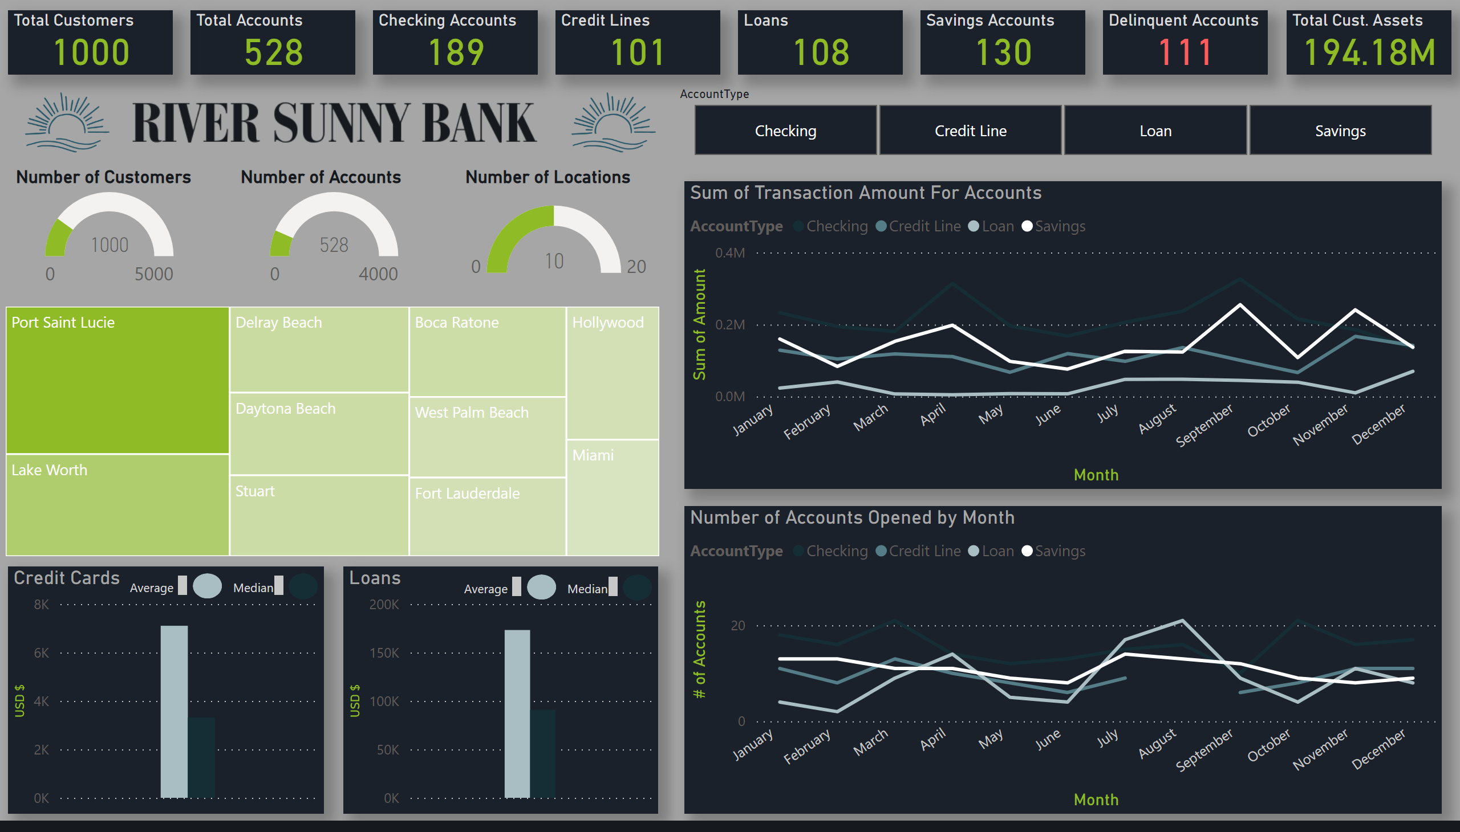
Visualization & Analytics
Overview
Notes:
Mason

Slide 27
Visualization & Analytics
Overview
Notes:
Introduce dashboard

Slide 28
Visualization & Analytics
Overview

Slide 29
Visualization & Analytics
Overview

Slide 30
Visualization & Analytics
Overview

Slide 31
Visualization & Analytics
Overview

Slide 32
Visualization & Analytics
Overview

Slide 33
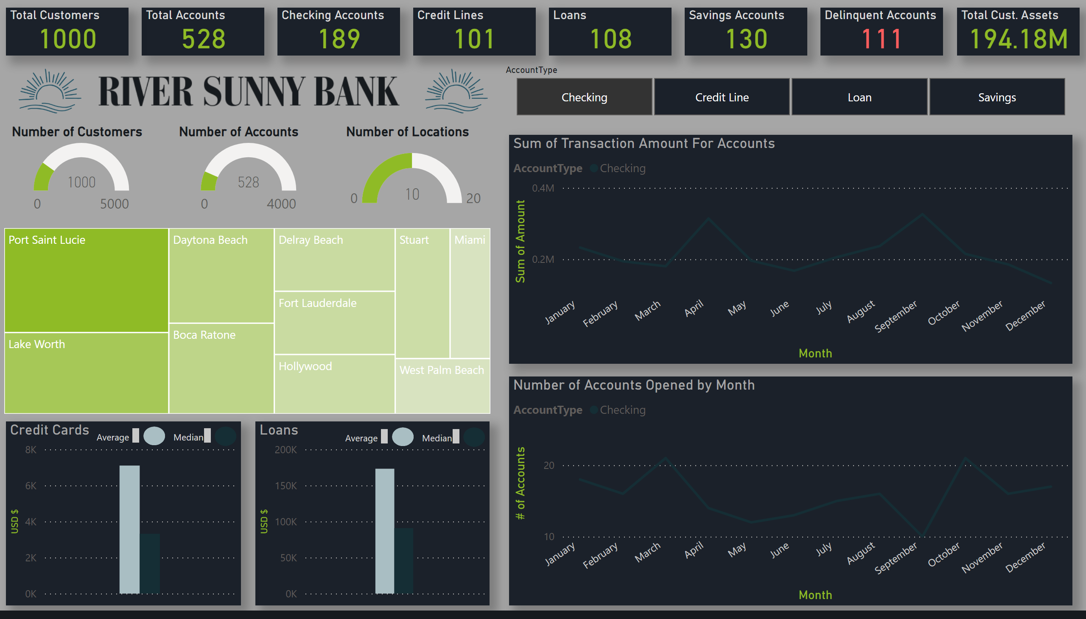
Visualization & Analytics
Overview
Notes:
Show how slicer changes the data

Slide 34
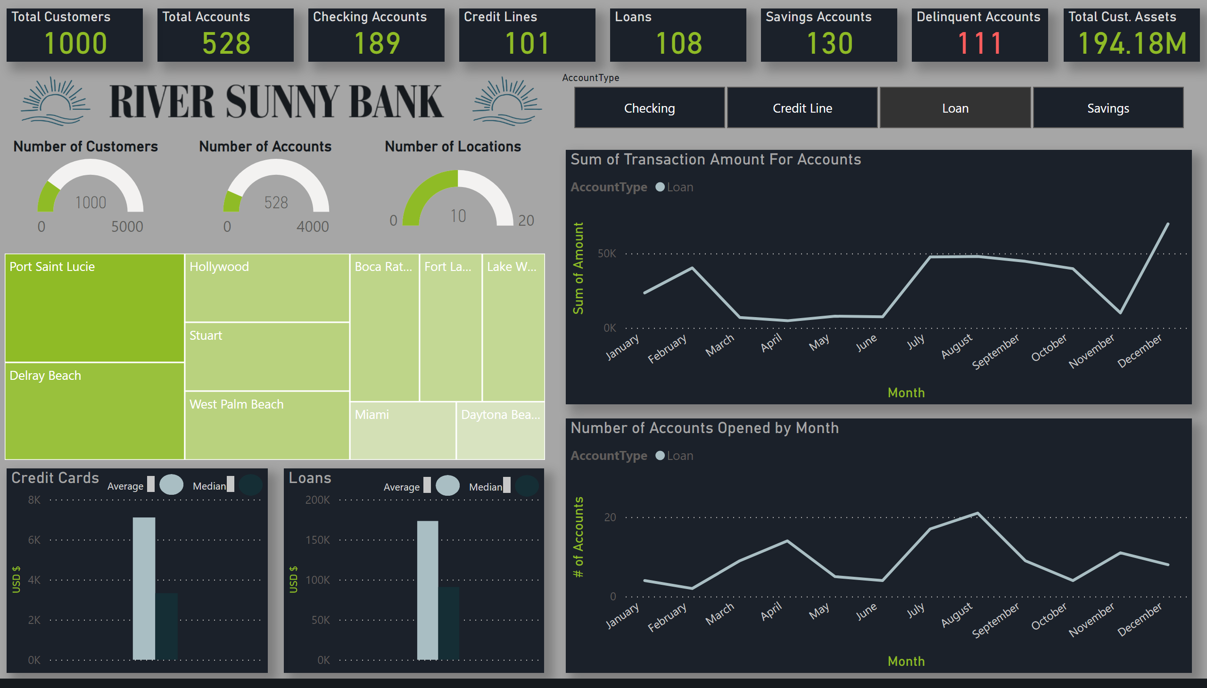
Visualization & Analytics
Overview

Slide 35
Visualization & Analytics
Insights
Top Regions w/ Most Accounts (Overall)
Port Saint Lucie | 107 Accounts
Lake Worth | 74 Accounts
Delray Beach | 50 Accounts
Daytona Beach | 48 Accounts
Stuart | 47 Accounts

Slide 36
Visualization & Analytics
Insights
Top Regions w/ Most Accounts For Checking Accounts
Port Saint Lucie | 36 Accounts
Lake Worth | 28 Accounts
Daytona Beach | 21 Accounts
Boca Raton| 20 Accounts
Delray Beach & Fort Lauderdale | 16 Accounts Each
Notes:
For checking accounts, we can see that the locations start to change but Port Saint Lucie and Lake Worth still remain the top two locations.

Slide 37
Visualization & Analytics
Insights
Top Regions w/ Most Accounts For Loans
Port Saint Lucie | 19 Accounts
Delray Beach| 17 Accounts
Hollywood | 11 Accounts
Stuart| 11 Accounts
West Palm Beach | 11 Accounts
Notes:
When we switch to Loan accounts, we can start to see a larger difference with Delray beach taking the new 2nd top spot and hollywood, Stuart, and West Palm Beach enter into the top 5.

Slide 38
Visualization & Analytics
Insights
Seasonal Trend For New Loans
March – May
July – September
Notes:
Keeping the slicer set to Loan we start to see a seasonal trend pattern in two periods over the year for account openings:
March to May
July to September

Slide 39
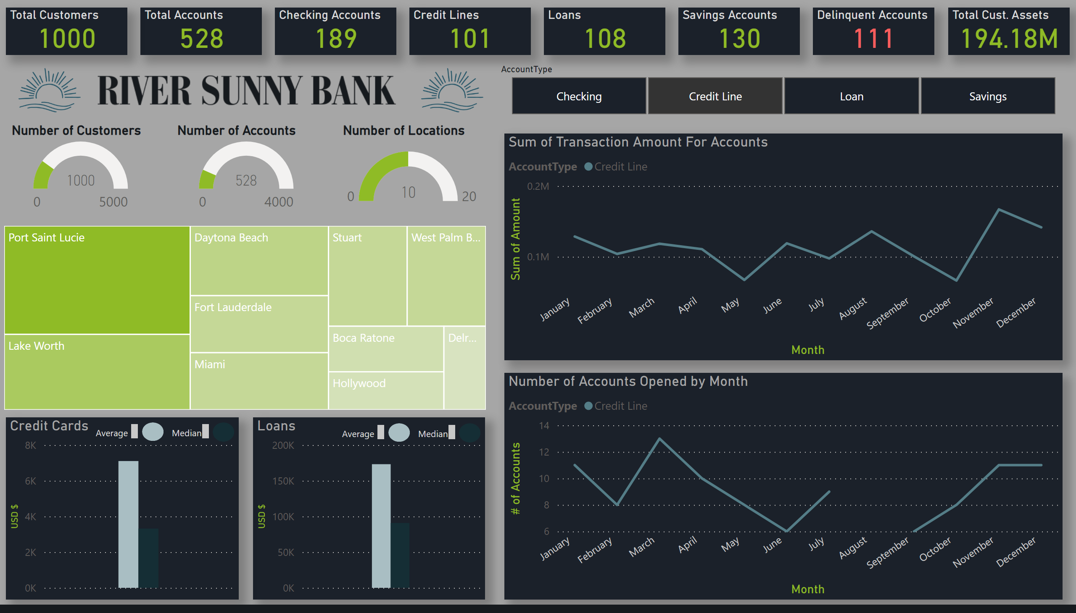
Visualization & Analytics
Insights
Credit Spending of Customers
Annual high during holidays peaking at $166,000 worth of transactions
Annual low in towards the end of October at just over $66,000 for all transactions
No new credit lines opened for August
Notes:
Lets see how our credit card holders are doing currently. Looking at the sum of all transactions monthly we can see that we climb from our annual low of $66,000 occurring at the end of October to our annual high of $166,000 occurring at the end of November. This of course makes sense as customers typical spend more in during the Holliday season.

Slide 40
Visualization & Analytics
Insights
Notes:
This dashboard served as a very brief look at our data to get various insights to how are bank is performing and describing specific patterns that cannot be seen simply by looking at hundreds of records. From here we can extend the dashboard to provide more powerful insight with more visuals and greater control of various entity attributes.

Slide 41
Documentation
Introduction
1.1 Purpose
The purpose of this project is to establish a robust MySQL database environment tailored for Sunny River Bank. This initiative will address specific database requirements, constraints, recommendations, and an estimated budget aligned with banking operations. 1.2 Scope of Project
The Database Capstone Project presents preliminary findings from our investigation into the feasibility of a comprehensive database system designed to meet the unique needs of Sunny River Bank.
Notes:
Sam

Slide 42
Documentation
Product Description
2.1 Description (Selected Platform)
The selected database platform for Sunny River Bank is SQL Server.
2.2 Problems and Opportunities
This section addresses a detailed analysis of problems, opportunities, and solutions related to Customer Information, Account Management, and Transaction Records.
Notes:
Sam

Slide 43
Documentation
Product Description – Special Requirements
2.3.1.1 User BankAdmin
Full control over the entire database.
Authority to modify, delete, or update any records.
Configuration and management of user roles and permissions.
Access to sensitive financial data for auditing and reporting.
2.3.1.2 User Teller
Access to customer account information for transactions.
Authority to process deposits, withdrawals, and fund transfers.
Limited access to sensitive customer data for transactional purposes.
View-only access to certain administrative reports.
2.3.1.3 User CustomerService
Access to customer information for account inquiries and support.
Ability to update customer contact details and personal information.
Limited access to transaction history for customer assistance.
View-only access to specific reports for customer service purposes.
2.3.1.4 User Auditor
Read-only access for auditing purposes.
Authority to run and review audit reports.
Access to transaction logs and system activity.
Limited access to specific financial reports for auditing purposes.
Notes:
Sam

Slide 44
Documentation
Product Description – Special Requirements
2.3.1.5 User ManagerialRoles
Access to managerial reports and analytics.
Authority to oversee and manage employee roles and permissions.
View-only access to sensitive financial reports.
Limited access to modify specific configurations for operational efficiency.
2.3.1.6 User ITAdministrator
Full control over database infrastructure.
Authority to implement and manage security protocols.
Configuration and maintenance of database backups.
Access to error logs and troubleshooting tools.
2.3.1.7 User Customer
Access to personal account information.
Ability to view transaction history.
Limited access to perform account-related actions (e.g., change password).
No access to sensitive administrative or financial reports.
2.3.1.8 User ComplianceOfficer
Access to regulatory compliance reports.
Authority to ensure database adherence to legal standards.
Limited access to sensitive customer data for compliance auditing.
View-only access to specific financial and regulatory reports.
Notes:
Sam

Slide 45
Documentation
Project Constraints
Constraints for River Sunny Bank, including both positive and negative aspects:
3.1.1.1 Clients can perform multiple transactions simultaneously (positive constraint)
3.1.1.2 Lack of automated email confirmations for transactions (negative constraint)
Notes:
Sam

Slide 46
Documentation
Overview of the Project
5.1 Problems Encountered
5.1.1 Sunny River Bank faced issues such as program interface crashes, Manager Login malfunction, Data grids not properly displaying transactions, and the supplier open button not consistently connecting to the database.
5.2 Recommendations
5.2.1 Enhance security measures to detect and prevent potential fraud.
5.2.2 Implement a user-friendly interface for customer transactions.
5.2.3 Explore cloud-based database solutions for secure backups.
5.3 Estimated Budget
5.3.1 Given the nature of a financial institution, the estimated budget for maintaining the database at Sunny River Bank is approximately $500 - $1,000 annually.
Notes:
Sam

Slide 47
Recommendation for Implementation
Security Protocols:
Prioritize robust security measures, including encryption and access controls, to safeguard sensitive financial data. Regularly update and test security protocols to stay ahead of emerging threats.
Scalability Planning:
Design the database architecture with scalability in mind, ensuring it can efficiently handle growing volumes of customer data, transactions, and additional functionalities as the bank expands its services.
Real-Time Transaction Monitoring:
Implement real-time transaction monitoring using triggers to detect and prevent fraudulent activities promptly. This includes triggers for suspicious transactions and alerts for potential security breaches.
User Role Management:
Define and implement distinct user roles with specific permissions to ensure secure access and data confidentiality. Roles such as BankAdmin, Teller, and CustomerService should have tailored access levels.
Notes:
Sam

Slide 48
Recommendation for Implementation
Stored Procedures for Operational Efficiency:
Develop and utilize stored procedures for routine operations, such as generating monthly statements and tracking employee attendance. This enhances operational efficiency and streamlines key processes.
Cloud-Based Backup Solutions:
Explore and implement cloud-based database solutions for secure and accessible data backups. This ensures data recovery in the event of system failures or unforeseen incidents, enhancing overall data resilience.
User-Friendly Interfaces:
Enhance the user interfaces for both customers and bank employees, ensuring a seamless and user-friendly experience. Consider implementing features like intuitive transaction interfaces and dashboards for efficient management.
Regular Performance Reviews:
Conduct regular performance reviews to assess the responsiveness and efficiency of the database system. Address any performance bottlenecks promptly to maintain optimal system functionality.
Notes:
Sam

Slide 49
Recommendation for Implementation
Training Programs:
Establish comprehensive training programs for bank employees to ensure they are well-versed in utilizing the database system effectively. This includes training on security protocols, data entry, and transaction processing.
Integration with External Systems:
Ensure seamless integration with external banking systems, such as payment gateways and financial reporting tools. This enhances data accuracy and facilitates efficient communication between different banking platforms.
Compliance with Regulatory Standards:
Regularly review and update the database system to comply with evolving regulatory standards in the financial industry. Stay informed about changes in data protection laws and banking regulations.
Monitoring and Auditing Tools:
Implement monitoring and auditing tools to track database activities. Regularly review logs and audit trails to identify any unusual patterns or potential security breaches.
Notes:
Sam

Slide 50
River Sunny Bank
Database Administration Capstone Project Fall 2023 – Group 3
Faculty: Dr. Theo Owusu
Presented By: Wahiba Pereira | Wenxin Liang | Samy Baker | Mason Young

Slide 51

Questions and Comments
Notes:
All

Slide 52
Notes:
All

